Slide 1
Chapter 6
Normalization of Database Tables

Slide 2
Chapter 6
Chapter 6, pages 200-233
219-223 - Higher Order Normal forms not needed
227-230 - Denormalization is not needed

Slide 3
What is Normalization?
Normalization: Normalization is the process of decomposing large, inefficiently structured tables into smaller, more efficient tables, without any data loss on the way i.e. evaluating and correcting table structures to minimize data redundancies
  Reduces data anomalies
  Assigns attributes to tables based on determination
Three primary goals of database design
  Store all data
  Avoid redundant storage of data
  Preserve relationships

Slide 4
Normal forms
Consists of normal forms.
  1NF
  2NF
  3NF
  Boyce & Codd normal form (BCNF)
  4NF
  5NF
  DKNF (Domain-Key Normal Form)
Normalization process is a progression
  Each normal form assumes that the requirements for the previous normal form(s) have been met.
  Each successive normal form creates a more effective and error-free relation set.
Relations normalized through 3NF are generally accepted as normalized enough.

Slide 5
Database Tables and Normalization
Structural point of view of normal forms
  Higher normal forms are better than lower normal forms
  Properly designed 3NF structures meet the requirement of fourth normal form (4NF)
Denormalization: produces a lower normal form
  Results in increased performance and greater data redundancy

Slide 6
The Need for Normalization
Used while designing a new database structure
  Analyzes the relationship among the attributes within each entity
  Determines if the structure can be improved through normalization
  Improves the existing data structure and creates an appropriate database design

Slide 7
Normalization in real world
Is it possible to have a database which is not normalized, but still works?
  Yes, sometimes database designers do this for multiple reasons. However, it is not a good practice
Is it possible to do normalization without going through the design process?
  Yes, sometimes you work with databases that were created before your arrival and have data in them. You can still improve the efficiency of design by normalization
Is it possible to avoid normalization altogether?
  Yes, if you were very careful in the data modeling stage and created perfect ERDs. Still, you should check for the normality of your resulting entities.

Slide 8
So, why normalize?
To ensure solid, efficient table structures. Improperly designed tables are usually subject to modification anomalies and data dependency problems. If you do not address these problems, your information will be inconsistent, inaccurate and sometimes totally invalid.

Slide 9
Modification anomalies
Things that can go wrong when you try to
  Insert
  Delete
  Update
data in your database

Slide 10
Insert anomaly
It may be of two types:
  Unnecessary constraint
    Usually, it is a subtle problem and harder to spot
  Unreasonable redundancy
    Usually more obvious

Slide 11
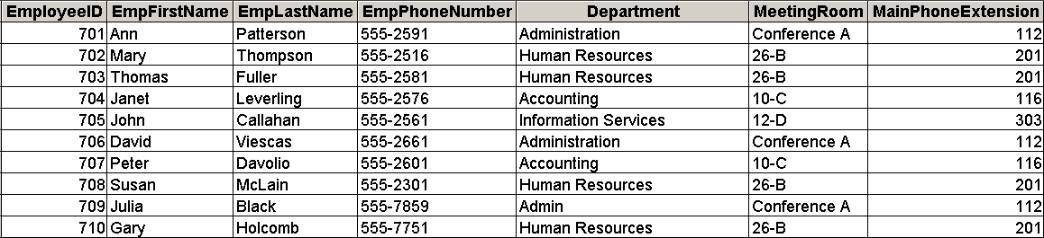
Unnecessary constraint
It is impossible to enter information about a new department,
unless we immediately assign an employee to that department

Slide 12
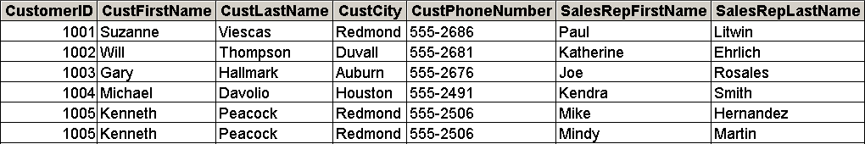
Unnecessary redundancy
When we try to update the sales rep info for customer 1005,
we need to repeat all the information

Slide 13
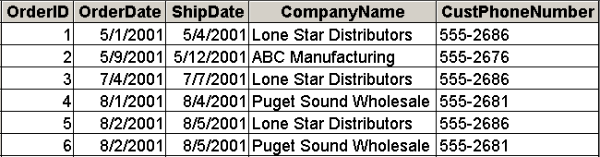
Update anomaly
It exists if changes to a specific value requires to update several records
Changes to the name of Lone Star Distributors propagate to three records

Slide 14
Delete anomaly
In this case, you lose data which was not meant for deletion. It may affect
  A single record
  Multiple records

Slide 15
Delete anomaly
Deleting information about Employee 705 will destroy the only record about the Information Services department

Slide 16
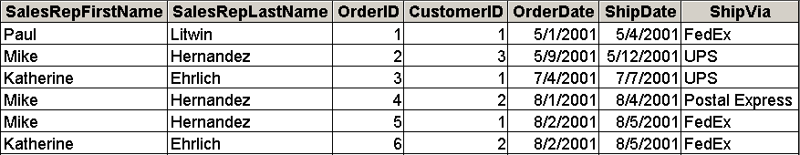
Delete anomaly
Deleting information about Mike Hernandez will result in loss of data for three orders!

Slide 17
Dependencies
The ideal design of a database is when each table represents information about a SINGLE subject (e.g., “student” table has information about name, address, etc., but not about courses like course title, section number, etc.)
This design is checked against dependencies among table fields
  Functional dependencies are good
  Transitive and partial dependencies are bad

Slide 18
Functional dependency
A functional dependency exists between two fields A and B, when a distinct value of A is directly associated with a distinct value of B.
Given a specific value of A, you can always find the corresponding value of B
  Student ID = 55058 → Student name = Bob Jones
Written as A→B
The value of A determines the value of B (A is the determinant, B is the dependent)
The value of B is functionally dependent on the value of A.

Slide 19
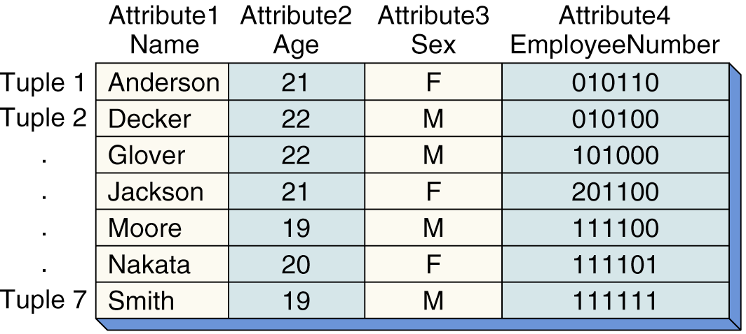
Functional Dependency
Is a “relationship between attributes”
Y is functionally dependent on X: (X Y)
if each value of X determines exactly one value of Y
EmployeeNumber Name
determinant
Definition: An attribute, Y, is functionally dependent on another attribute, X
(or possibly a collection of attributes), if a value for X determines a single
value for Y at any given time.
Page 114

Slide 20
The Normalization Process (5 of 5)
Partial dependency: functional dependence in which the determinant is only part of the primary key
  Assumption: one candidate key
  Straight forward
  Easy to identify
Transitive dependency: attribute is dependent on another attribute that is not part of the primary key
  More difficult to identify among a set of data
  Occur only when a functional dependence exists among nonprime attributes

Slide 21
Partial dependency
Partial dependency: functional dependence in which the determinant is only part of the primary key
This applies only if you have a table with a composite primary key.
Let’s say that you have a primary key consisting of two fields (A,B)
Then, suppose that there is a field C such that A→C. Since only one component of the key determines the field C, C is only partially dependent on the key (A,B)
This is bad because it tells us that there are multiple subjects in the table

Slide 22
Transitive dependency
Transitive dependency: attribute is dependent on another attribute that is not part of the primary key
  More difficult to identify among a set of data
  Occur only when a functional dependence exists among nonprime attributes
Suppose there are three fields in a single table : A, B, C
Suppose A→B and B→C
Then, A transitively (indirectly) determines C via B (written A⇒C)
So, why are they bad for us?
  Because each table is supposed to be about one subject. Transitive dependencies tell us that there are multiple subjects in a table.

Slide 23
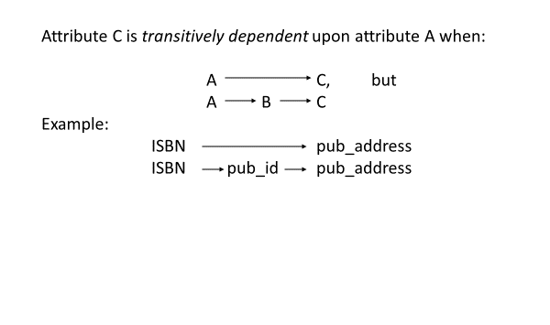
Transitive Dependence

Slide 24
Partial dependency
Student_ID | Course_ID | Student_name | Course_Title | Grade
54025 | FIN 101 | Jones | Intro Finance | A
45011 | FIN 101 | Smith | Intro Finance | C
25632 | OPIM 203 | Lee | Bus.info.systems | B+
45011 | OPIM 203 | Smith | Bus.info.systems | A
98621 | OPIM 203 | Brown | Bus.info.systems | B
Are there any partial dependencies here?

Slide 25
Transitive Dependency
Book_ID | Authod_ID | Author | Book | Author_Nationality
Book_001 | A01 | Orson Scott Card | Ender's Game | United States
Book_002 | A02 | Margaret Atwood | Stone Mattress | Canada
Book_003 | A02 | Margaret Atwood | The Handmaid's Tale | Canada

Slide 26
The Normalization Process
Objective is to ensure that each table conforms to the concept of well-formed relations
  Each table represents a single subject
  Each row/column intersection contains only one value and not a group of values
  No data item will be unnecessarily stored in more than one table
  All nonprime attributes in a table are dependent on the primary key
  Each table has no insertion, update, or deletion anomalies
Ensures that all tables are in at least 3NF
  Higher forms are not likely to be encountered in business environment

Slide 27
The Normalization Process (3 of 5)
Normal Form | Characteristic
First normal form (1NF) | No composite attributes, no multivalued attribute, no repeating groups, and PK identified
Second normal form (2NF) | 1NF and no partial dependencies
Third normal form (3NF) | 2NF and no transitive dependencies

Slide 28
Conversion to First Normal Form (1NF) (1 of 3)
Repeating group: group of multiple entries of same type can exist for any single key attribute occurrence
  Reduces data redundancies
Three step procedure
  Eliminate the repeating groups
  Identify the primary key
  Identify all dependencies
Dependency diagram: depicts all dependencies found within given table structure
  Helps to get an overview of all relationships among table’s attributes
  Makes it less likely that an important dependency will be overlooked

Slide 29
First Normal Form
A primary key candidate defined.
All attributes are atomic.
No attribute contains multiple values in a row (multivalued attribute).
There are no repeating groups of data.
Example:
Customer(CID, Name: First + Last, Phones, Address)
CID | Name: First + Last | Phones | Address
111 | Joe Jones | 111-2223 111-3393 112-4582 | 123 Main

Slide 30
Second Normal Form
All relations must be in 1NF, and
Each relation must not have any partial dependency
Example:
OrderProduct(OrderID, ProductID, OrderQuantity, ProductDescription)
OrderID | ProductID | OrderQuantity | ProductDescription
32 | 15 | 1 | Blue Hose
32 | 16 | 2 | Pliers
33 | 15 | 2 | Blue Hose

Slide 31
Third Normal Form
Relation is in Second Normal Form.
No transitive dependencies (no non-key attributes functionally determine other non-key attributes).

Slide 32
Third Normal Form
Relation below is not in third normal form.
Example:
Order(EmployeeID, Job, MinSalaryofJob)
EmployeeID | Job | MinSalaryofJob
1 | Elec. Engineer | 90000
2 | Data Analyst | 110000
3 | Chemical Engineer | 95000

Slide 33
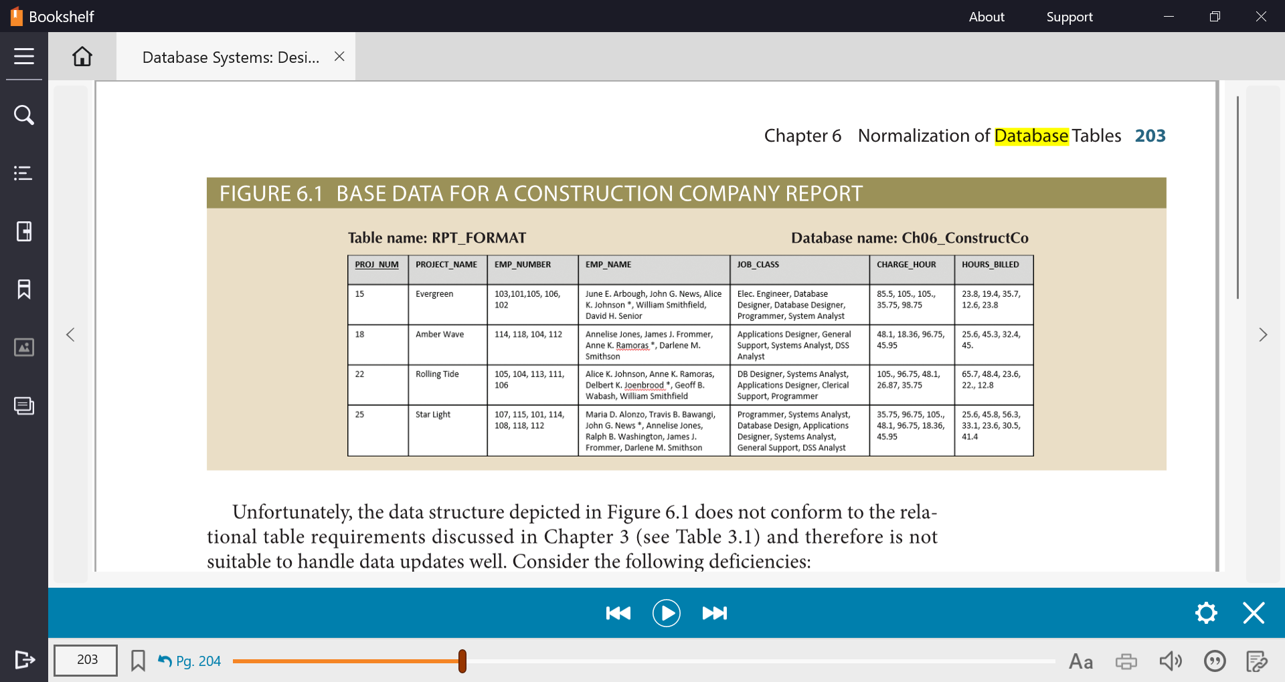




Book Example
UNF
(PROJ_NUM, PROJ_NAME, EMP_NUM, EMP_NAME, JOB_CLASS, CHG_HOURS, HOURS)

Slide 34







Conversion to First Normal Form (1NF)
Analysis:
There are repeating groups starting from EMP_NUMBER. Isolate these into its own relation.
EMP_NAME is a composite attribute, break it down to simple attributes.
Carry a copy of Original table key in the isolated part to maintain the link.
1NF
PROJECT (PROJ_NUM, PROJ_NAME)
EMPLOYEE_ASSIGN (EMP_NUM, PROJ_NUM, EMP_FNAME, EMP_LNAME, JOB_CLASS, CHG_HOURS, HOURS_BILLED)

Slide 35

Conversion to Second Normal Form (2NF)
Analysis:
Partial dependency exists only when the PK is a composite key.
Only the EMPLOYEE_ASSIGN relation has a composite PK. So, it must be evaluated for partial dependency.
2NF
PROJECT (PROJ_NUM, PROJ_NAME)
EMPLOYEE (EMP_NUM, EMP_FNAME, EMP_LNAME, JOB_CLASS, CHG_HOURS)
ASSIGN (EMP_NUM, PROJ_NUM, HOURS_BILLED)

Slide 36



Conversion to Third Normal Form (3NF)
Rules and Analysis
All relations must be in 2NF, and
Each relation must not have any transitive dependency, which exists only when a relation has more than one non-prime attribute.
Table EMPLOYEE has more than one non-prime attribute – so need to be evaluated for transitive dependency.
It is important the determinant remains in the original table to serve as foreign key.
3NF
PROJECT (PROJ_NUM, PROJ_NAME)
EMPLOYEE (EMP_NUM, EMP_FNAME, EMP_LNAME, JOB_CLASS)
JOB (JOB_CLASS, CHG_HOURS)
ASSIGN (EMP_NUM, PROJ_NUM, HOURS_BILLED)
Are we done??

Slide 37




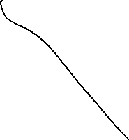







Slide 38
Improving the Design
Normalization is valuable because its use helps eliminate data redundancies
  Evaluate PK assignments and naming conventions
  Identify new attributes and new relationships
  Refine primary keys as required for data granularity
    Granularity: Level of detail represented by the values stored in a table’s row
  Maintain historical accuracy and evaluate using derived attributes

Slide 39
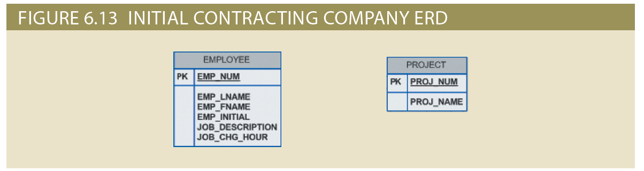
Normalization and Database Design (2 of 6)

Slide 40
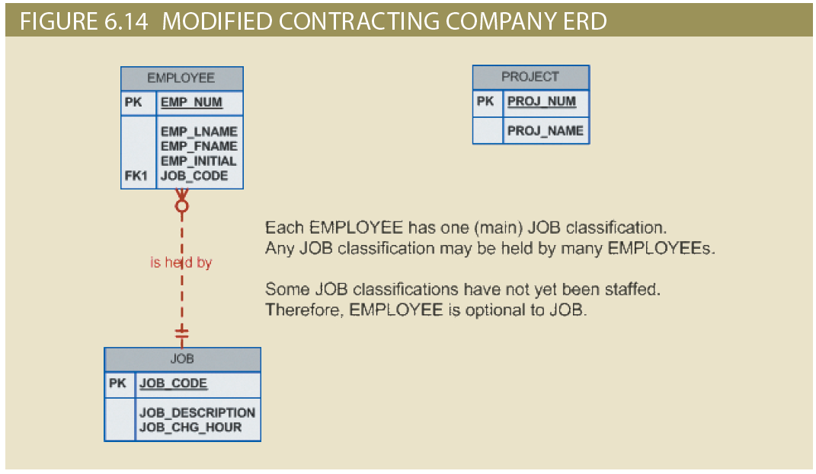
Normalization and Database Design (3 of 6)

Slide 41
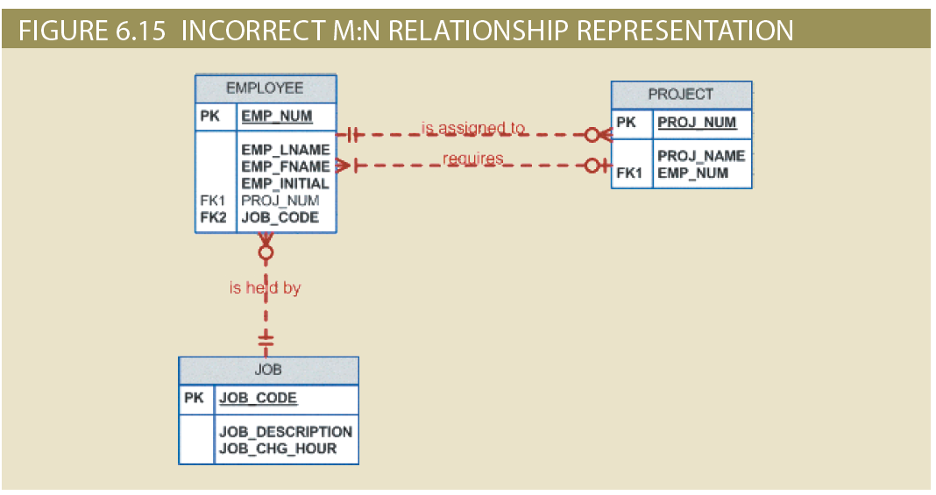
Normalization and Database Design (4 of 6)

Slide 42
Data-Modeling Checklist (1 of 6)
Business rules
  Properly document and verify all business rules with the end users
  Ensure that all business rules are written precisely, clearly, and simply
    The business rules must help identify entities, attributes, relationships, and constraints
  Identify the source of all business rules, and ensure that each business rule is justified, dated, and signed off by an approving authority

Slide 43
Data-Modeling Checklist (2 of 6)
Data modeling
  Naming conventions: all names should be limited in length (database-dependent size)
Entity names:
  Should be nouns that are familiar to business and should be short and meaningful
  Should document abbreviations, synonyms, and aliases for each entity
  Should be unique within the model
  For composite entities, may include a combination of abbreviated names of the entities linked through the composite entity

Slide 44
Data-Modeling Checklist (3 of 6)
Attribute names:
  Should be unique within the entity
  Should use the entity abbreviation as a prefix
  Should be descriptive of the characteristic
  Should use suffixes such as _ID, _NUM, or _CODE for the PK attribute
  Should not be a reserved word
  Should not contain spaces or special characters such as @, !, or &
Relationship names:
  Should be active or passive verbs that clearly indicate the nature of the relationship

Slide 45
Data-Modeling Checklist (4 of 6)
Entities:
  Each entity should represent a single subject
  Each entity should represent a set of distinguishable entity instances
  All entities should be in 3NF or higher
    Any entities below 3NF should be justified
  Granularity of the entity instance should be clearly defined
  PK should be clearly defined and support the selected data granularity

Slide 46
Data-Modeling Checklist (5 of 6)
Attributes:
  Should be simple and single-valued (atomic data)
  Should document default values, constraints, synonyms, and aliases
  Derived attributes should be clearly identified and include source(s)
  Should not be redundant unless this is required for transaction accuracy, performance, or maintaining a history
  Nonkey attributes must be fully dependent on the PK attribute
Relationships:
  Should clearly identify relationship participants
  Should clearly define participation, connectivity, and document cardinality

Slide 47
Data-Modeling Checklist (6 of 6)
ER model:
  Should be validated against expected processes: inserts, updates, and deletions
  Should evaluate where, when, and how to maintain a history
  Should not contain redundant relationships except as required (see attributes)
  Should minimize data redundancy to ensure single-place updates
  Should conform to the minimal data rule: All that is needed is there, and all that is there is needed

Slide 48
Summary (1 of 2)
Normalization is a technique used to design tables in which data redundancies are minimized
A table is in 1NF when all key attributes are defined, and all remaining attributes are dependent on the primary key
A table is in 2NF when it is in 1NF and contains no partial dependencies
A table is in 3NF when it is in 2NF and contains no transitive dependencies
A table that is not in 3NF may be split into new tables until all of the tables meet the 3NF requirements
Normalization is an important part—but only a part—of the design process

Slide 49
Summary (2 of 2)
The larger the number of tables, the more additional I/O operations and processing logic you need to join them
The data-modeling checklist provides a way for the designer to check that the ERD meets a set of minimum requirements

Slide 50
Examples
Is in 1 NF?explain
Employee (Employee_Id, Name)
Student (Student_Id, Name, Address, Phone number)
Order (Order_Id, Order date, itemnames) [Note: An order must have at least 2 different items]
Is in 2 NF?explain
Skillset(emp_id, skill_id, emp_name)
ENROLL(course_id, stud_id, grade, course_name)
Teaches ( Student_Id,Teacher_Id, Teaching Time)

Slide 51
Exercise 1
Normalize the following database till 3rd normal form (show all steps UNF to 3NF). Create ERD also.
Order Database
Cust No | Cust Name | Tel No | Order No | Order Date | Product No | Product Name | Product price | Qty Ordered
C123 | Nancy | 123-456-7849 | 235 | 04/10/2002 | P23 | Monitor | 650 | 2
C101 | Yuan Lee | 345-789-2345 | 110 | 01/23/2002 | P45 | Printer | 250 | 3
 |  |  |  |  | P65 | Color Printer | 400 | 4
 |  |  |  |  | P132 | Scanner | 250 | 2
C245 | S Bhatia | 657-456-2378 | 27 | 02/18/2002 | P132 | Scanner | 250 | 3
 |  |  | 42 |  | P24 | Color Scanner | 450 | 5
 |  |  |  | 03/18/2020
C461 | John Olson | 456-234-6745 | 95 | 05/07/2002 | P46 | Laser Scanner | 650 | 10

Slide 52







Slide 53






Exercise 2
Normalize the following UNF. Check till third normal form.
Book (ISBN, BookTitle, Author_Num, Last Name, Publisher name, Publisher_address, Royalty)
Business Rules:
A book may have more than one author
An author may write several books
Create ERD as well.

Slide 54
Book (ISBN, BookTitle, Author_Num, Last Name, Publisher name, Publisher_address, Royalty)
BOOKPUB(isbn, book_title, edition, pub_name, pub_house_num, pub_street,
pub_city, pub_state, pub_zip, pub_country
AUTH(isbn, auth_num, last_name
2nf
BOOKPUB(isbn, book_title, edition, pub_name, pub_house_num, pub_street,
pub_city, pub_state, pub_zip, pub_country
BOOK(isbn, auth_num, royalty
AUTH(auth_num, last_name
3nf
PUB(pub_name, pub_house_num, pub_street, pub_city, pub_state, pub_zip,
pub_country)
BOOK(isbn, edition, pub_name)
BOOKAUTH(isbn, auth_num, royalty?)
AUTH(auth_num, last_name)

Slide 55
Exercise 3
Normalize the following database till 3rd normal form (show all steps UNF to 3NF). Create ERD also.
Implement the following business requirement in your design as well.
An employee may act as manager of a department but is not required to do so. However, a department has one and only one manager.

Slide 56
1NF: No RGs, no comp atts, many multivals
EMPLOYEE(emp_num, emp_lastname, job_class, dept_code, dept_name, emp_title, emp_dob, emp_hiredate, job_class_base_salary)
og mv EMP_ED(emp_num, emp_ed_id, emp_ed)
og mv EMP_DEP(emp_num, emp_dep_id, emp_dep
og mv EMP_TRAIN(emp_num, emp_train_id, emp_train
2NF: no partial dependencies, same as 1NF
3NF: transitive dependencies; emp_num -> job_class -> job_class_base_salary, emp_num -> dept_code -> dept_name
EMPLOYEE(emp_num, emp_lastname, job_class, dept_code, emp_dob, emp_hiredate, manager_id)
JOB(job_class, job_class_base_salary)
DEPARTMENT(dept_code, dept_name)
EMP_ED(emp_num, emp_ed_id, emp_ed)
EMP_DEP(emp_num, emp_dep_id, emp_dep)
EMP_TRAIN(emp_num, emp_train_id, emp_train)

Slide 57








